Slide 1


CITS1003 Introduction to Cybersecurity [2] Cryptography Exercises
Dr Zhi Zhang

Slide 2
Outline
Crack the code
Key space
Sharing secrets
Possible questions

Slide 3
Crack the code
nbcm cm u nij mywlyn gymmuay nbun sio uly lykoclyx ni xywixy ch ilxyl ni mifpy nby jlivfyg myn ion ni sio ch zlihn. biqypyl sio uly qyfwigy ni omy pulciom lymiolwym ni byfj sio mifpy nbcm jlivfyg, qbcwb sio gus zchx omyzof von cn myygm nbun nbcm mcgjfy jlivfyg wiofx vy mifpyx yumcfs vs omcha migy uonigunyx niifm mowb um wsvylwbyz.
Find live lectures from here: https://github.com/uwacyber/cits1003/tree/2022s1/cits1003-lecture_slides
For week 2: CITS1003-2 Cryptography-exercises

Slide 4
Crack the code
How did you do it?

Slide 5
Crack the code
Boxentriq Cryptogram auto solver: https://www.boxentriq.com/code-breaking/cryptogram

Slide 6
Crack the code
CyberChef : https://gchq.github.io/CyberChef/
nbcm cm u nij mywlyn gymmuay nbun sio uly lykoclyx ni xywixy ch ilxyl ni mifpy nby jlivfyg myn ion ni sio ch zlihn. biqypyl sio uly qyfwigy ni omy pulciom lymiolwym ni byfj sio mifpy nbcm jlivfyg, qbcwb sio gus zchx omyzof von cn myygm nbun nbcm mcgjfy jlivfyg wiofx vy mifpyx yumcfs vs omcha migy uonigunyx niifm mowb um wsvylwbyz.

Slide 7
Crack the code
How did you do it?
Will your approach work for other encoded messages? Why or why not?

Slide 8
Crack the code
You are given a ciphertext as follows:
ymnx nx ymj gjxy xjsyjshj jajw
Applying cryptanalysis, what is the likely letter for “e”, “t” and “a” (the top 3 most frequent letters)?

Slide 9
Crack the code
We have the frequency as follows (sorted):
Plaintext: this is the best sentence ever
So “j” mapped to “e”, and “y” to “t”
j : 7
y : 4
x : 4
m : 2
n : 2
s : 2
g : 1
h : 1
a : 1
w : 1

Slide 10
Crack the code
Frequency auto-analysis: https://www.dcode.fr/frequency-analysis

Slide 11
Crack the code
This works because?

Slide 12
Crack the code
This works because?
This might not work because?

Slide 13
Key space
Caesar Cipher
Polyalphabetic cipher (e.g., Vigenere)
Monoalphabetic cipher
DES
3DES
AES

Slide 14
Key space
Caesar Cipher:

Slide 15
Key space
Caesar Cipher: 26

Slide 16
Key space
Caesar Cipher
right-shift plaintext with 1 position
A → B
right-shift plaintext with 27 positions
A → B
right-shift plaintext with 2 positions
A → C
right-shift plaintext with 26 positions
A → A

Slide 17
Key space
Polyalphabetic cipher (e.g., Vigenere):

Slide 18
Key space
Polyalphabetic cipher (e.g., Vigenere): 26^n

Slide 19
Key space
For “A”, there are 26 options.
For “B”, there are 26 options.
…
For “Z”, there are 26 options.
Polyalphabetic cipher (e.g., Vigenere)
key size: n letters in total
key space: 26^n

Slide 20
Key space
Monoalphabetic cipher

Slide 21
Key space
Monoalphabetic cipher: 26!

Slide 22
Key space
For “A”, there are 26 options.
For “B”, there are 25 options.
…
For “Z”, there is 1 option.
Monoalphabetic cipher:
key space: 26!

Slide 23
Key space
Polyalphabetic cipher (e.g., Vigenere): multiple alphabet for substitution
26^n
Monoalphabetic cipher: single alphabet for substitution
26!

Slide 24
Key space
DES:

Slide 25
Key space
DES: 2^56

Slide 26
Key space
3DES:

Slide 27
Key space
3DES: 2^168 or 2^112.

Slide 28
Key space
AES

Slide 29
Key space
AES: 2^128, 2^192 or 2^256

Slide 30
Sharing secrets
Our symmetric key cipher systems are fast and secure.
But how do we make sure the key is shared between the two parties securely?
Answer: Asymmetric key cipher – public key cryptography (PKC), e.g., RSA.
But how to use PKC for secrets sharing?

Slide 31





share a key
Bob’s public key
Insecure Internet
Bob’s private key
a shared key
encrypted
a shared key
Alice
Bob

Slide 32

share a key
Bob’s public key
Insecure Internet
Bob’s private key
a shared key
encrypted key
a shared key
Alice
Bob
encrypted key
a shared key

Slide 33
Possible questions
Easy
Why do we salt passwords before hashing them?
Are hash functions secure?
Your Diffie-Hellman key exchange didn’t work, what went wrong?

Slide 34
Possible questions
Easy
Why do we salt passwords before hashing them?

Slide 35
Possible questions
Easy
Why do we salt passwords before hashing them?

Slide 36
Possible questions
Easy
Why do we salt passwords before hashing them?
Are hash functions secure?

Slide 37
Possible questions
Easy
Why do we salt passwords before hashing them?
Are hash functions secure?

Slide 38
Possible questions
Easy
Why do we salt passwords before hashing them?
Are hash functions secure?
Your Diffie-Hellman key exchange didn’t work, what went wrong?

Slide 39
Possible questions
Easy
Why do we salt passwords before hashing them?
Are hash functions secure?
Your Diffie-Hellman key exchange didn’t work, what went wrong?

Slide 40
Possible questions
Medium - hard
In what scenario is it safe to use CBC mode?
If the performance isn’t an issue, does n-DES improve security? Why? Any limitations?
Using the split cipher as before, what are the properties of the plaintext that would allow us to fully utilise the key space?
Does adding additional substitution and/or transposition layers in an encryption improve security?

Slide 41
Possible questions
Medium - hard
In what scenario is it safe to use CBC mode?

Slide 42
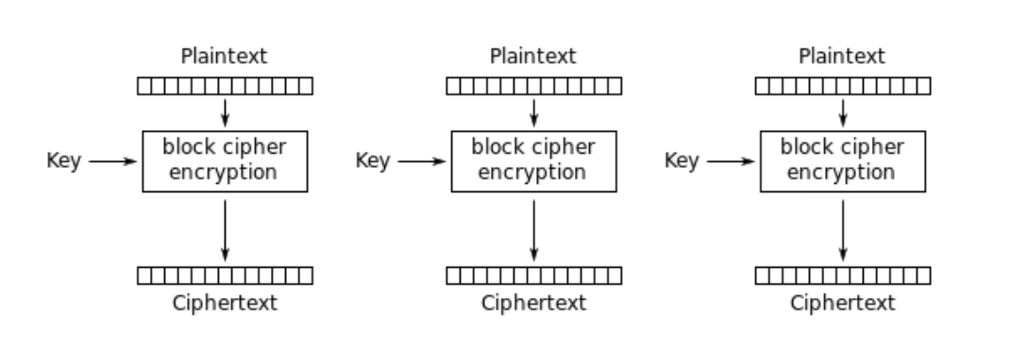
Possible questions
Medium - hard
In what scenario is it safe to use ECB mode?
ECB (Electronic Codebook): Each block is encrypted independently

Slide 43
Possible questions
Medium - hard
In what scenario is it safe to use ECB mode?
If the performance isn’t an issue, does n-DES improve security? Why? Any limitations?

Slide 44
Possible questions
Medium - hard
In what scenario is it safe to use ECB mode?
If the performance isn’t an issue, does n-DES improve security? Why? Any limitations?

Slide 45
Possible questions
Medium - hard
In what scenario is it safe to use CBC mode?
If the performance isn’t an issue, does n-DES improve security? Why? Any limitations?
Take a split cipher as an example, it uses Caesar cipher and Vigenère cipher upon a given plaintext. What are the properties of the plaintext that would allow us to fully utilise the key space?

Slide 46
Possible questions
Medium - hard
In what scenario is it safe to use CBC mode?
If the performance isn’t an issue, does n-DES improve security? Why? Any limitations?
Take a split cipher as an example, it uses Caesar cipher and Vigenère cipher upon a given plaintext. What are the properties of the plaintext that would allow us to fully utilise the key space?

Slide 47
plaintext: XXX…X & AAA…A
XXX…X is encoded by Caesar cipher
AAA…A is encoded by Vigenère cipher
plaintext | XXX…X
Caesar cipher key (pick one from 26 English letters) | e.g., A
ciphertext | YYY…Y

Slide 48
plaintext: XXX…X & AAA…A
XXX…X is encoded by Caesar cipher
AAA…A is encoded by Vigenère cipher
plaintext | XXX…X
Caesar cipher key (pick one from 26 English letters) | e.g., A
ciphertext | YYY…Y
plaintext | AAA…A
Vigenère cipher key (pick 26 different English letters) | e.g., ABC…Z
ciphertext | BCD…A

Slide 49
Possible questions
Medium - hard
In what scenario is it safe to use CBC mode?
If the performance isn’t an issue, does n-DES improve security? Why? Any limitations?
Take a split cipher as an example, it uses Caesar cipher and Vigenère cipher upon a given plaintext. What are the properties of the plaintext that would allow us to fully utilise the key space?
Does adding additional substitution and/or transposition layers in an encryption improve security? Why?

Slide 50
Possible questions
Medium - hard
In what scenario is it safe to use CBC mode?
If the performance isn’t an issue, does n-DES improve security? Why? Any limitations?
Take a split cipher as an example, it uses Caesar cipher and Vigenère cipher upon a given plaintext. What are the properties of the plaintext that would allow us to fully utilise the key space?
Does adding additional substitution and/or transposition layers in an encryption improve security? Why?

Slide 51
An example
plaintext | A
Caesar cipher key | A
ciphertext | B
plaintext | A
Caesar cipher key | A | C (equivalent )
 | B
ciphertext | D | D
Adding an extra substitution layer essentially does not enhance the security.

Slide 52
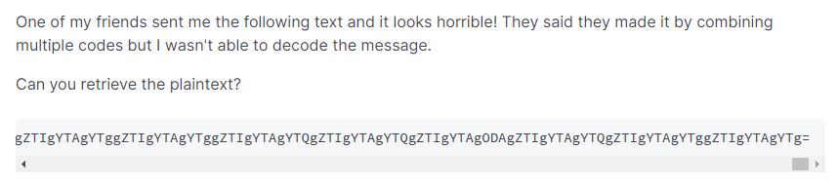
Lab 2
Q5: crypto mess

Slide 53
Lab 2
Hints: 1. figure out the representing code that is used by the text.
What code can generate a text with “=” at the end?
What code can generate a text of numbers 0-10 and letters A-F?
2. figure out the cipher that is used by the text
What cipher can generate a text with dots?
What cipher can generate a text with dots and dashes?

